Slide 1
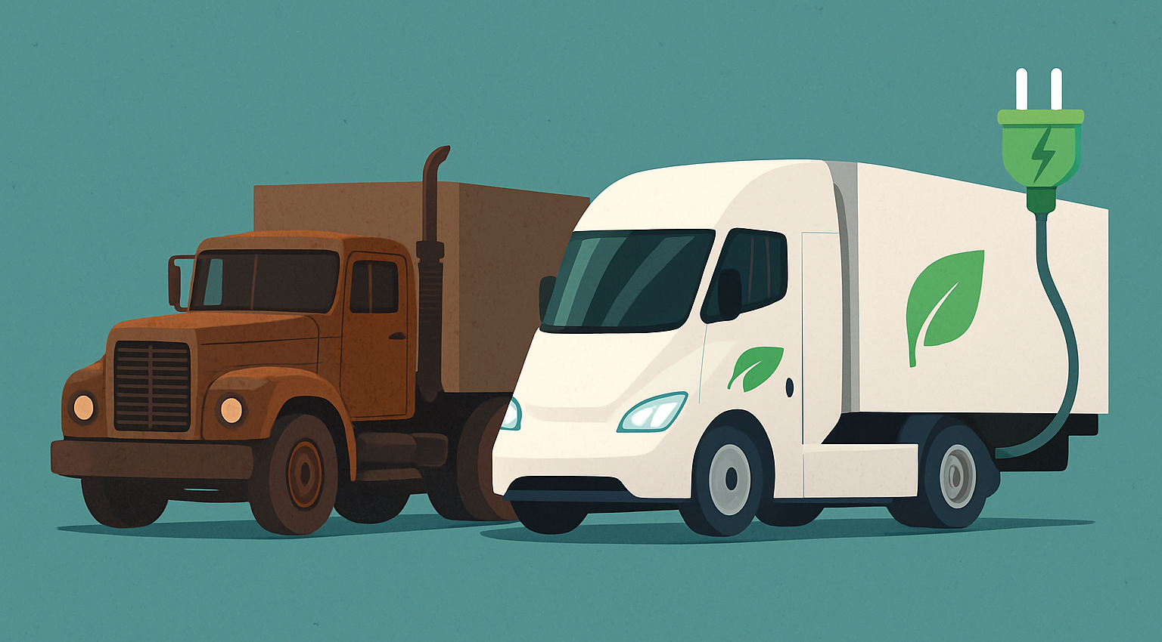


From Diesel to Electric:
Implementing Electric Truck Mode in Statewide Forecasting Model
Fatemeh Ranaiefar
Kaveh Shabani
September 17.2025

Slide 2
Agenda
01
02
03
04
05
06
Introduction
Legislation
Truck Market Trend
EV Truck Market Share
Demand
Methodology

Slide 3
Electrification Regulations Talks!
The California Governor’s Executive Order N-79-20 By 2035,
All new autos and trucks sold in California be ZE vehicles.
100 percent of medium- and heavy-duty drayage trucks operation be ZE, and by 2045 all other operations be ZE.
100 percent ZE off-road all vehicles and equipment where feasible.
California needs waivers from EPA to enforce stricter vehicle emissions standards than federal law
The Federal Administration revoked the EPA waver (as of Jun 12)
California Governor’s Executive Order N-27-25
Notes:
Issued by California Governor Newsom on Sept. 23, 2020. It sets state goals for 100% of new passenger car and truck sales in CA to be zero-emission by 2035; similarly, medium & heavy-duty vehicles by 2045, or 2035 for “drayage” trucks
California needs waivers from EPA to enforce stricter vehicle emissions standards than federal law. Some have been granted; others are contested. On January 6, 2025, EPA issued a notice of decision granting CARB’s request for a waiver for its Heavy-Duty Vehicle & Engine “Omnibus” standards.
Trump on June 12 signed Congressional resolutions that revoked the EPA waiver for three California vehicle emissions rules. Last month, Congress passed a Congressional Review Act measure to block California from implementing the Advanced Clean Cars II regulation, Advanced Clean Trucks regulation, and the Heavy-Duty Low-NOx Omnibus rule.
In June 2025, California issued Executive Order N-27-25 which directs CARB to continue enforcing Advancing Clean Trucks (ACT) / Advanced Clean Fleets (ACF) and Omnibus rules regardless of federal challenges / disapprovals. California claims that the CRA disapprovals of the waivers are not enforceable.
In August 2025 EPA proposed allowing California to implement an inspection and maintenance rule for heavy-duty vehicles registered in the state, a measure aimed at reducing smog-forming pollutants.

Slide 4
Research Question:
California Statewide Freight Forecasting Model includes truck-only, rail-only, air, multi-modal modes
The mode choice is based on an incremental logit model.
Mode share is calculated for base year and updated based on changes in relative utility for each year.
CA is interested in adding a new “E-Truck” mode to the model to evaluate various electrification scenarios.
How can we efficiently add this new mode without historic mode share data?

Slide 5
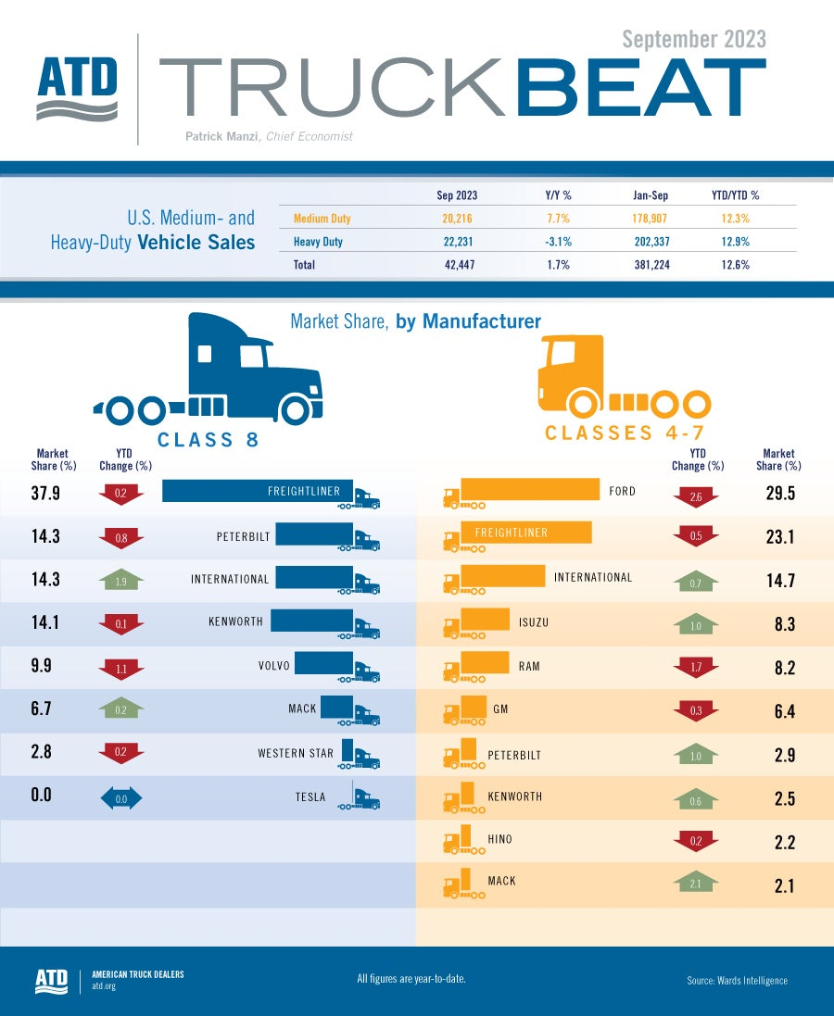
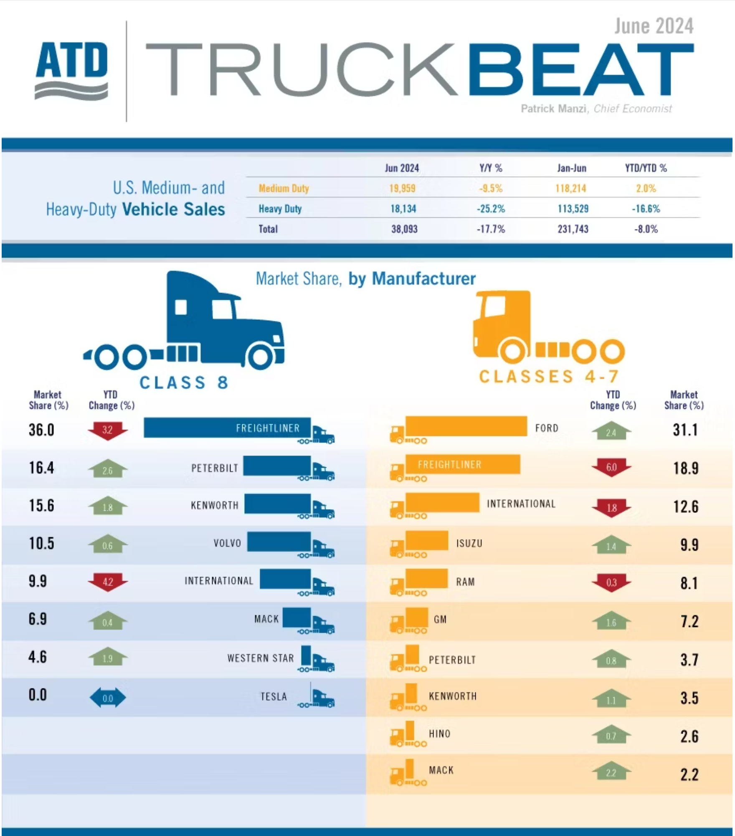

Slide 6
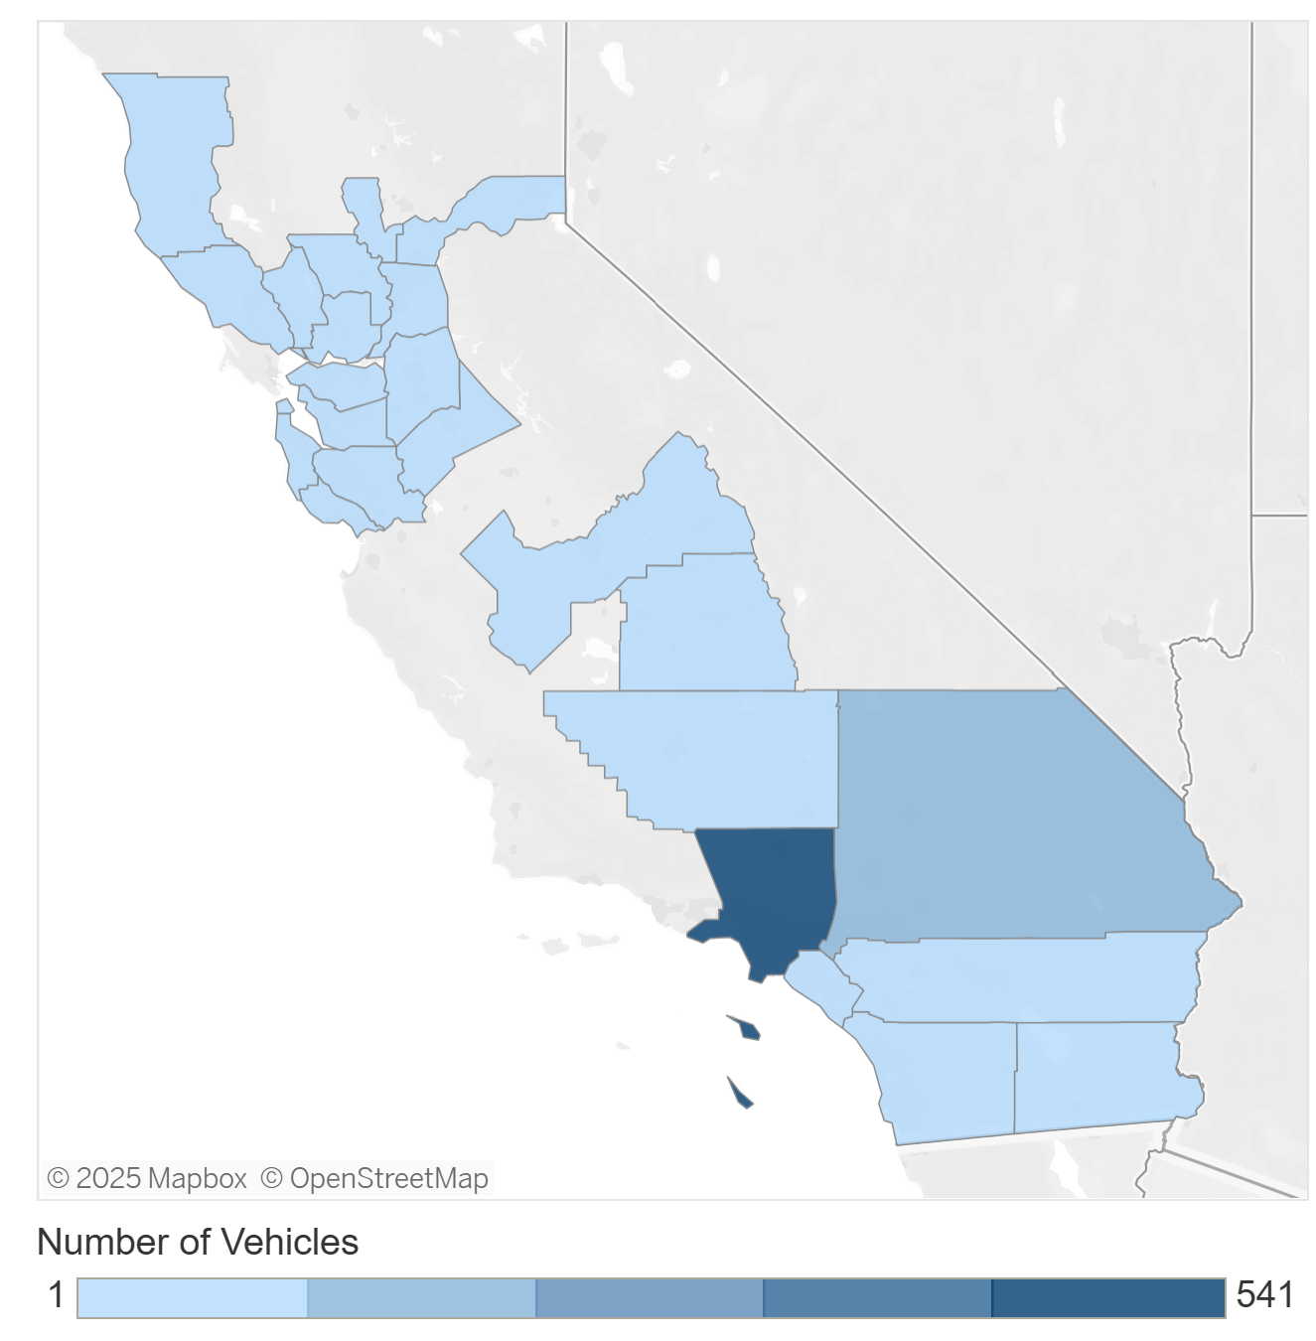
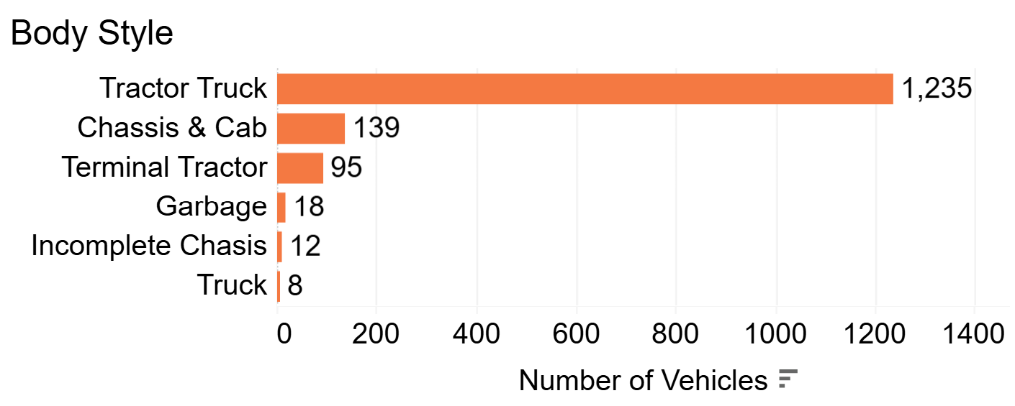
Electrification Trend
In 2024, 1.86 M medium and heavy trucks were registered in California. Of those, 1,507 are ZE trucks (including Hydrogen fueling).
California will need more battery-electric Class 8 trucks to haul the same amount of freight
"For every 1,000 trucks, an additional 343 trucks would be required due to battery weight”-ATRI report, 2022.
Source: CEC
Notes:
Issued by California Governor Newsom on Sept. 23, 2020. It sets state goals for 100% of new passenger car and truck sales in CA to be zero-emission by 2035; similarly, medium & heavy-duty vehicles by 2045, or 2035 for “drayage” trucks
California needs waivers from EPA to enforce stricter vehicle emissions standards than federal law. Some have been granted; others are contested. On January 6, 2025, EPA issued a notice of decision granting CARB’s request for a waiver for its Heavy-Duty Vehicle & Engine “Omnibus” standards.
Trump on June 12 signed Congressional resolutions that revoked the EPA waiver for three California vehicle emissions rules. Last month, Congress passed a Congressional Review Act measure to block California from implementing the Advanced Clean Cars II regulation, Advanced Clean Trucks regulation, and the Heavy-Duty Low-NOx Omnibus rule.
In June 2025, California issued Executive Order N-27-25 which directs CARB to continue enforcing Advancing Clean Trucks (ACT) / Advanced Clean Fleets (ACF) and Omnibus rules regardless of federal challenges / disapprovals. California claims that the CRA disapprovals of the waivers are not enforceable.
In August 2025 EPA proposed allowing California to implement an inspection and maintenance rule for heavy-duty vehicles registered in the state, a measure aimed at reducing smog-forming pollutants.

Slide 7

Truck Electrification Data
California Air Resource Board EMission FACtors (EMFAC)
Version 2021 V1.0.2
Annual estimates of vehicle population by county, fuel type, and vehicle class
Percent of e-truck population by county
Annual data from 2000 to 2050

Slide 8
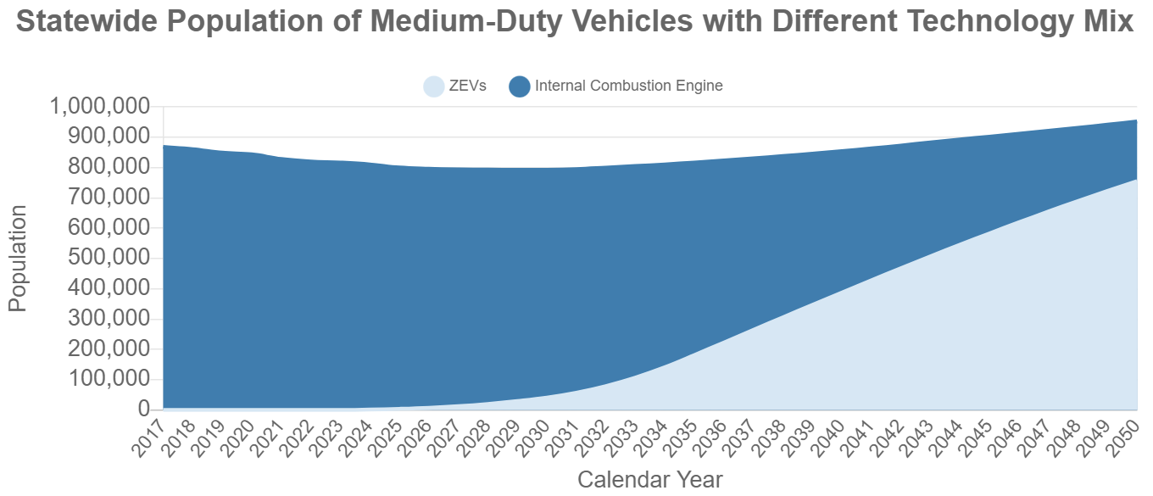
Truck Electrification Adoption Rates Projection
EMFAC uses socio-econometric regression analysis to forecast new vehicle sales and VMT growth, factoring in fuel prices and population trends.
Notes:
0% for Light Trucks, <2% for Medium Trucks, and <10% for Heavy Trucks
Truck population and trip adoption rates were compared; used trip adoption rates since differences were very small.

Slide 9
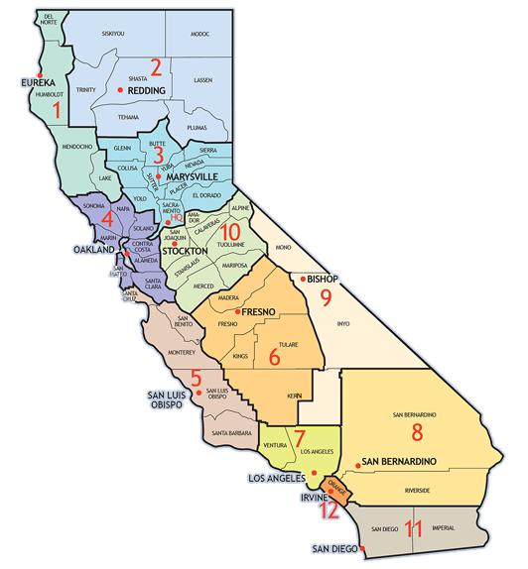
EMFAC Data – Electric Trucks Adoption Rates
District | 2035 | 2045 | 2050
1 | 10% | 27% | 34%
2 | 10% | 25% | 29%
3 | 14% | 33% | 38%
4 | 16% | 36% | 41%
5 | 13% | 33% | 39%
6 | 12% | 26% | 29%
7 | 17% | 36% | 41%
8 | 14% | 30% | 33%
9 | 12% | 29% | 35%
10 | 12% | 27% | 32%
11 | 16% | 34% | 38%
12 | 18% | 38% | 44%
 | 15% | 33% | 38%
Notes:
Medium and heavy trucks (classes 5-8 in weight-based classification system)

Slide 10
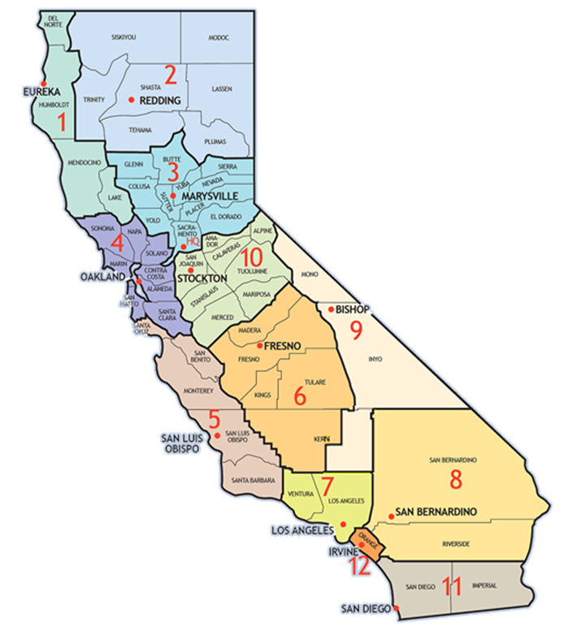
EMFAC Data – Electric Truck Adoption Rates By Truck Weight Class
Medium Trucks
Heavy Trucks
District | 2035 | 2045 | 2050
1 | 18% | 41% | 48%
2 | 20% | 43% | 49%
3 | 22% | 46% | 51%
4 | 21% | 45% | 52%
5 | 20% | 44% | 50%
6 | 21% | 44% | 49%
7 | 22% | 46% | 52%
8 | 22% | 45% | 51%
9 | 19% | 42% | 48%
10 | 20% | 42% | 48%
11 | 21% | 45% | 51%
12 | 20% | 45% | 51%
 | 21% | 45% | 51%
District | 2035 | 2045 | 2050
1 | 10% | 18% | 21%
2 | 8% | 14% | 15%
3 | 10% | 17% | 19%
4 | 10% | 17% | 19%
5 | 10% | 18% | 20%
6 | 8% | 13% | 14%
7 | 10% | 17% | 18%
8 | 9% | 14% | 15%
9 | 8% | 11% | 12%
10 | 9% | 15% | 16%
11 | 9% | 15% | 16%
12 | 11% | 21% | 23%
 | 9% | 15% | 17%

Slide 11

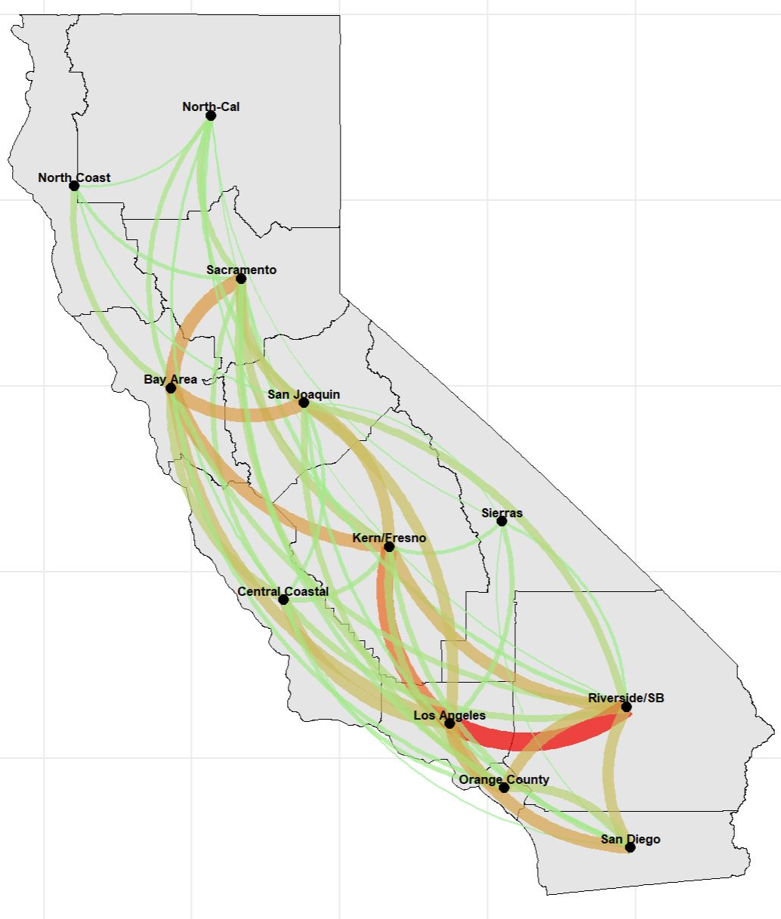
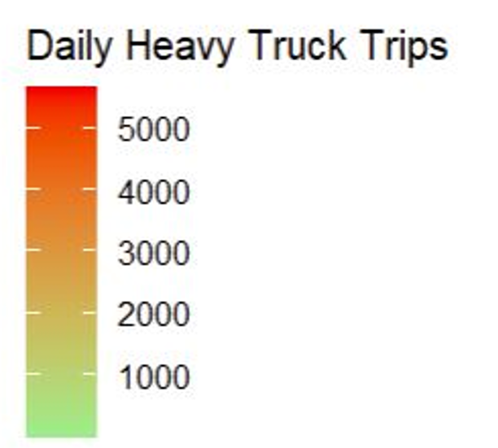
Heavy Truck Trips
per day – by origin
2,200
1,700
16,800
44,200
13,300
700
22,200
9,600
26,600
59,100
14,800
18,700

Slide 12
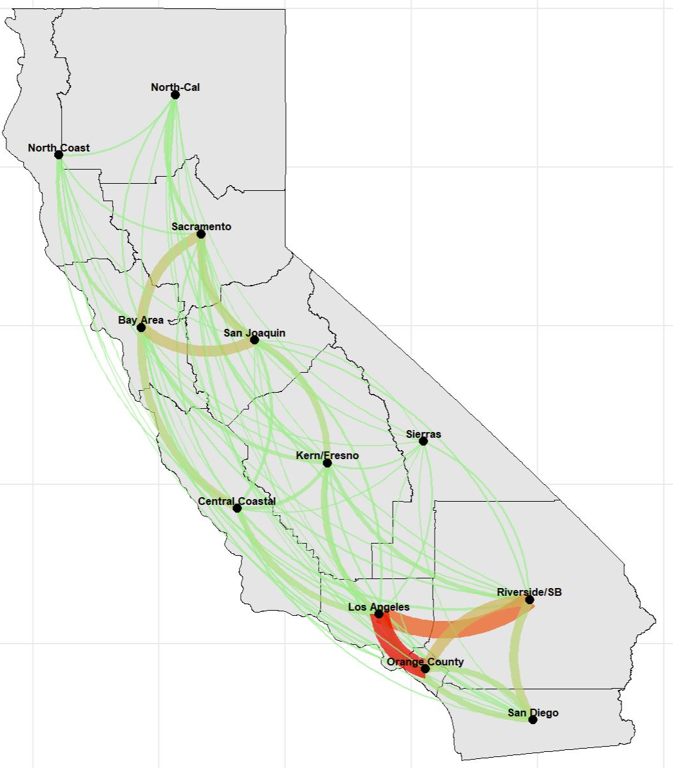
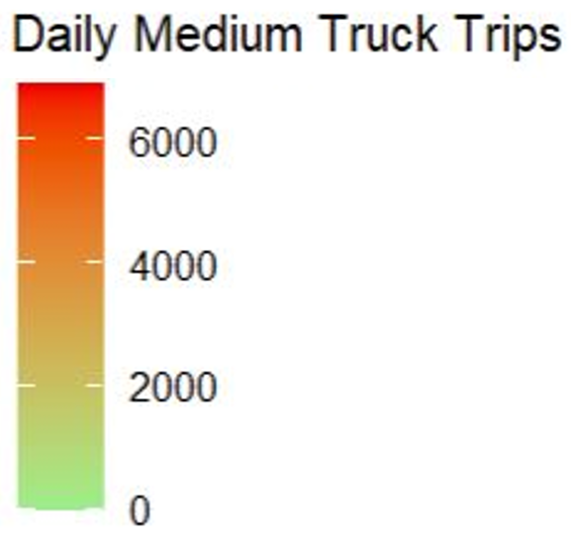
Medium Truck Trips per day – by origin
4,200
4,300
46,900
156,500
22,400
300
35,500
24,400
57,500
192,000
59,200
58,800

Slide 13
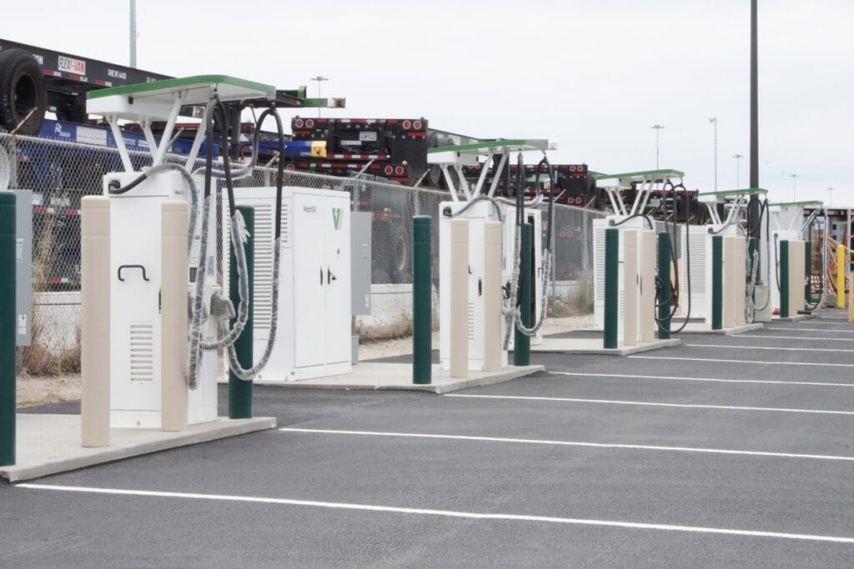
Setup #1 – by Origin
Evaluating electrification scenarios
Percent of truck trips by market segment
Adoption rate by truck type by region
Define high/medium/low scenarios for adoption rates by district
Model Implementation:
Drayage trucks: Trips from/ to ports and intermodal facilities
Non- drayage trucks: by origin’s zone

Slide 14
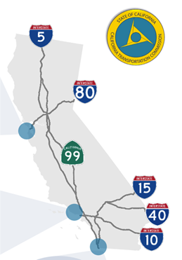
Setup #2 – by Trip Length and Route
CA has identified priority corridors for electrification.
Average TL range is key in electrification scenarios, but electric truck adoption rates by distance band is not available in EMFAC
Evaluating electrification scenarios
Percent of truck trips by market segment
Adoption rates by truck type by route
Define high/medium/low scenarios for adoption rates considering:
Discharge rates varies by distance traveled (and other factors)
Model Implementation
Drayage trucks: Trips from/ to ports and intermodal facilities
Non- drayage trucks: Trips by distance and route
Source: SB 671 Clean Freight Corridor Efficiency Assessment

Slide 15
Preliminary Implementation
The final O-D tables are split of E-Truck and D-Truck based on percent of EV penetration at origin zone.
The final assignment does not include fuel classification, due to limitations of number of matrices for multi-class assignment procedure.
The final skim is used to calculate VMT by fuel type.

Slide 16
Next Steps
Incorporate as part of the mode choice model
Add more performance measures such as corridor level mode share
Develop new scenarios
Include hydrogen fueling

Slide 17
Questions
f.ranaiefar@fehrandpeers.com

Slide 18
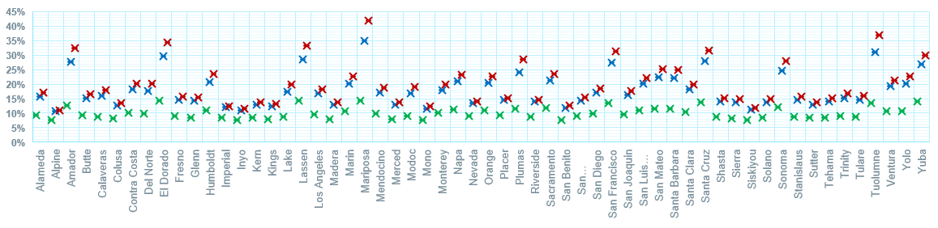
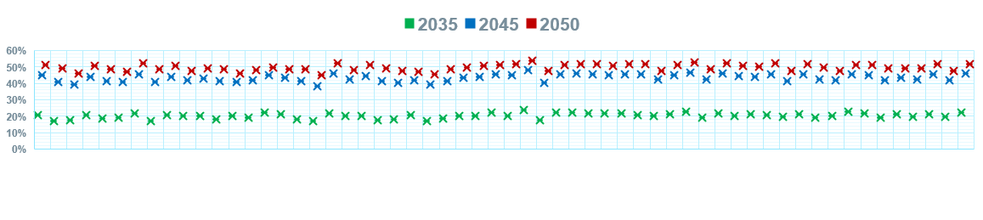
EMFAC – County Electrification Trends
Medium Trucks
Heavy Trucks

